Slide 1
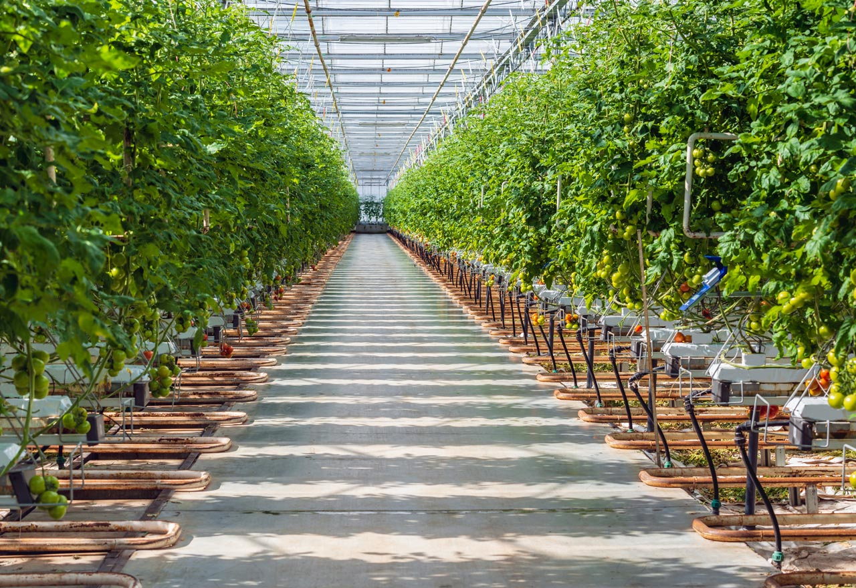

ECEN 403 Final Presentation Team 57: Deep Learning for Hydroponic Soybean Growth Team members: Samuel He, Mary Hughes Sponsor: Sambandh Dahl, Krishna Gadepally

Slide 2
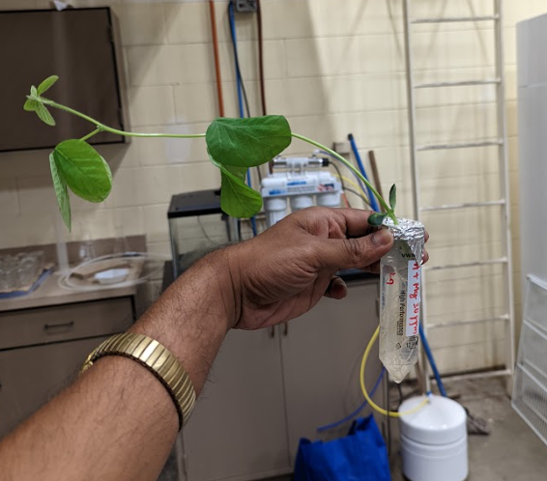
Project Description
Problem Statement:
Researchers take time to track the solution and day of growth of a hydroponically grown plant
Solution
Deep learning model and user interface that tracks
Nutrient Solution
Day of Growth
Image 1. Sample Data Image

Slide 3
System Diagram
Annotated Images (Train & Test Model)
UI Front End
Deep Learning Model
UI Back End
User Input Image
JSON Data
.JPG Data
Prediction
Samuel He
Mary Hughes

Slide 4
Deep Learning Model
Mary Hughes
For 403, we are using a deep learning model trained by our sponsor using the data set that was annotated earlier this semester by Samuel.
Due to time constraints and the size of the data set, this model outputs a range of days of the growth phase, rather than a specific day, and does not predict the nutrient solution the plant was grown in.

Slide 5
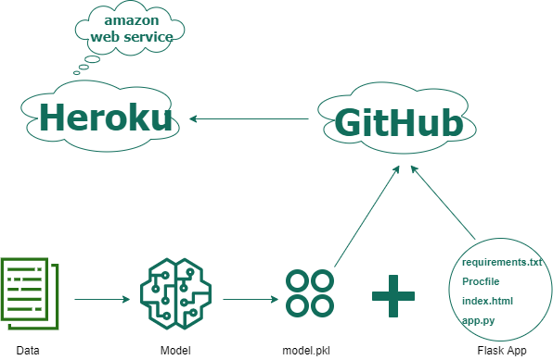
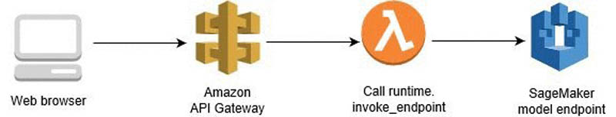
Communication with Model
Mary Hughes
Option 1: Integrated AWS
Created REST API
Written Lambda function/event handler
Created SageMaker Endpoint
Changed IAM roles, permissions, and policies
Option 2: Heroku
Use Heroku to host both the front end and backend (separately).
Build backend in Flask, use GET and POST HTTP requests to communicate with the model.
Notes:
For our web app to properly communicate with (any) model hosted in SageMaker, you have to use API gateway calls. API calls will create an event that invokes AWS Lambda. The Lambda function must prepare data and invoke the endpoint. To invoke an endpoint, you have to ensure that you have appropriate IAM roles, policies, and permissions.

Slide 6
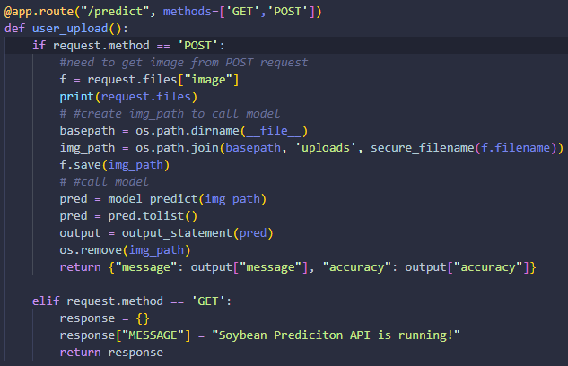
Communication with Model (Flask Back End)
Mary Hughes

Slide 7
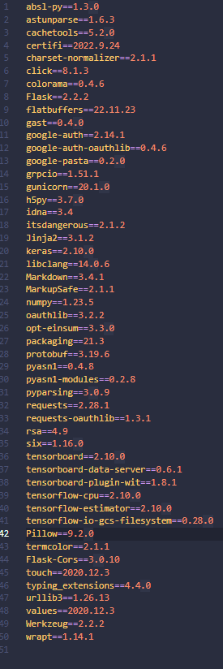

User Interface
Samuel He
Finished:
Deployed End to End Connections ~40 hours
Back End:
CORS permissions to prevent unwanted access
Dependencies:
Heroku dependencies and buildpack fixes
Tensorflow is picky

Slide 8
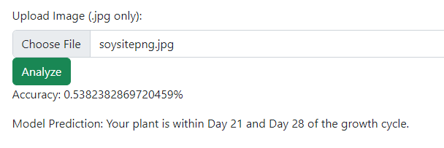
User Interface (front end)
Samuel He
In Progress/To do:
UI Styling: ~1 hours
ReactJS (Web Framework)
Bootstrap (CSS Library)

Slide 9
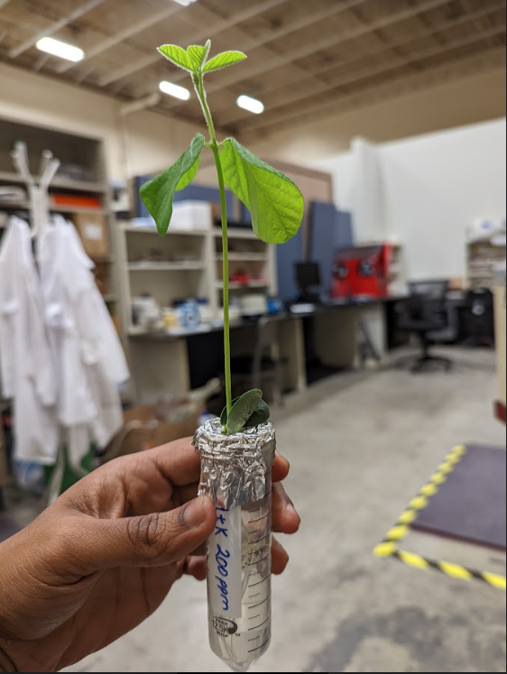
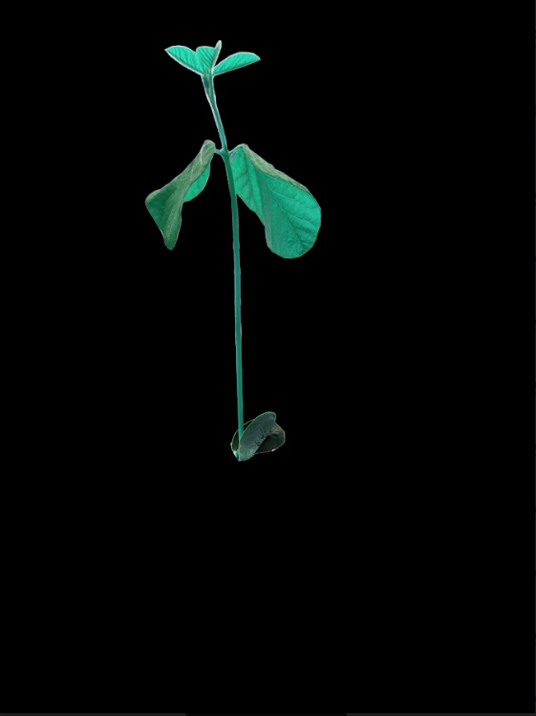
Image Processing
Samuel He
Image annotation – CVAT (Computer Vision Annotation Tool)
Using segmentation and classification for feature extraction purposes
CVAT segmentation

Slide 10
Future Goals & Plans
404:
Training and testing our own deep learning model from scratch
Potentially expanding the scope of the model
Perfecting web app
Security
Testing
Styling

Slide 11
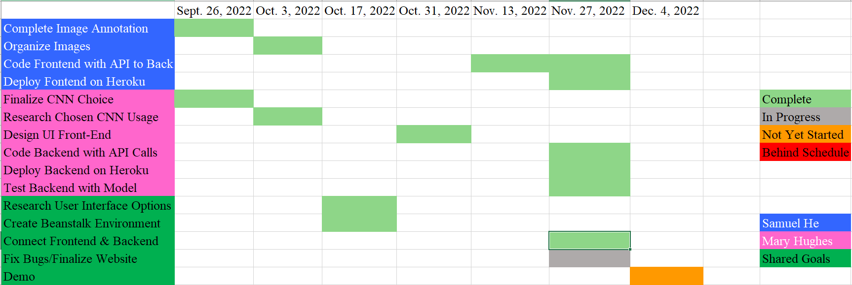
Execution Plan

Slide 12
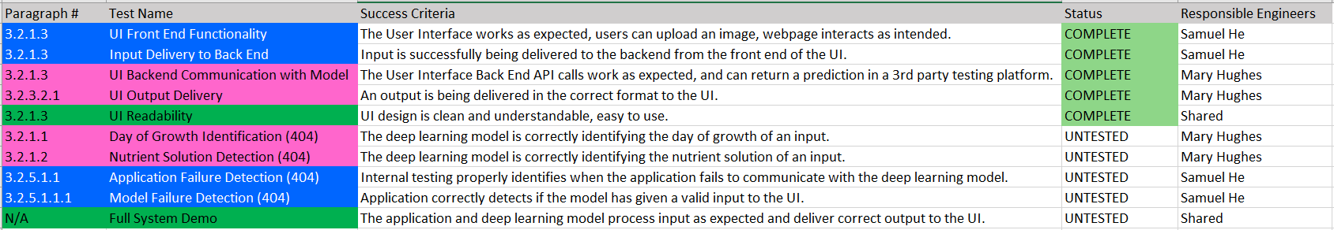
Validation plan

Slide 13
Questions?

